Slide 1
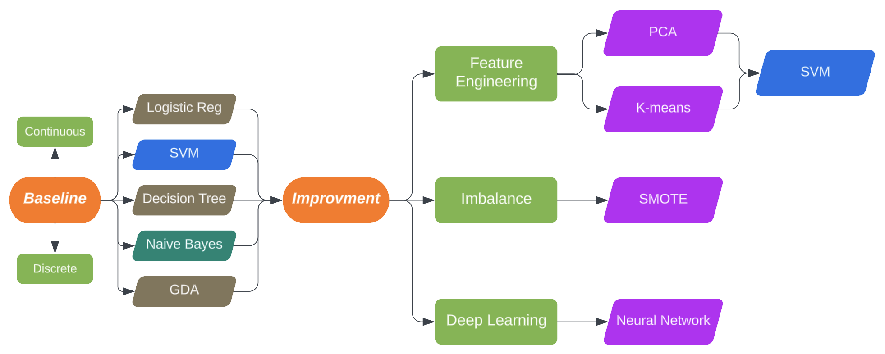
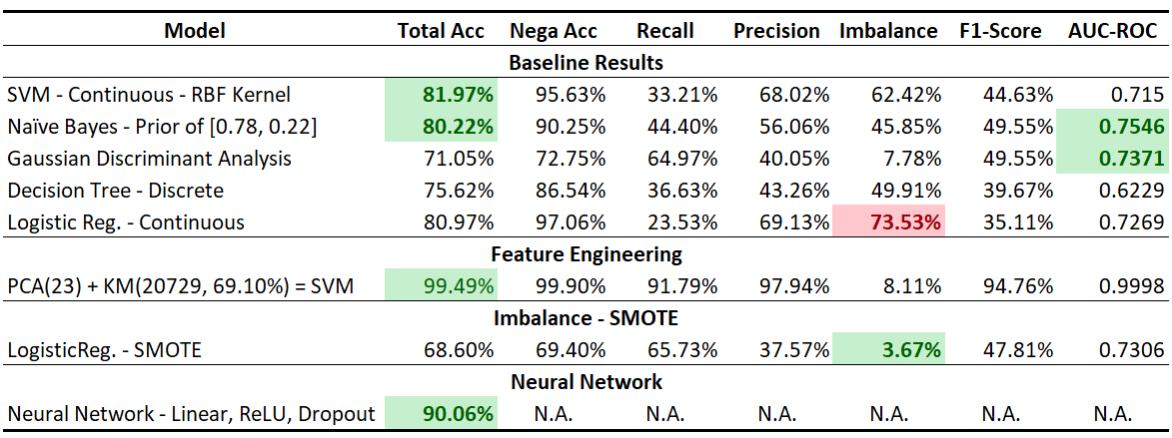
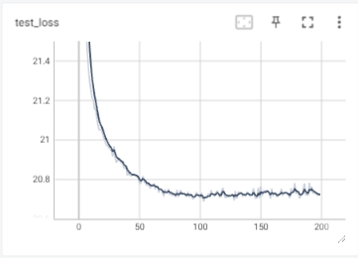
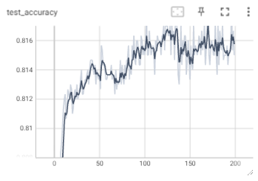
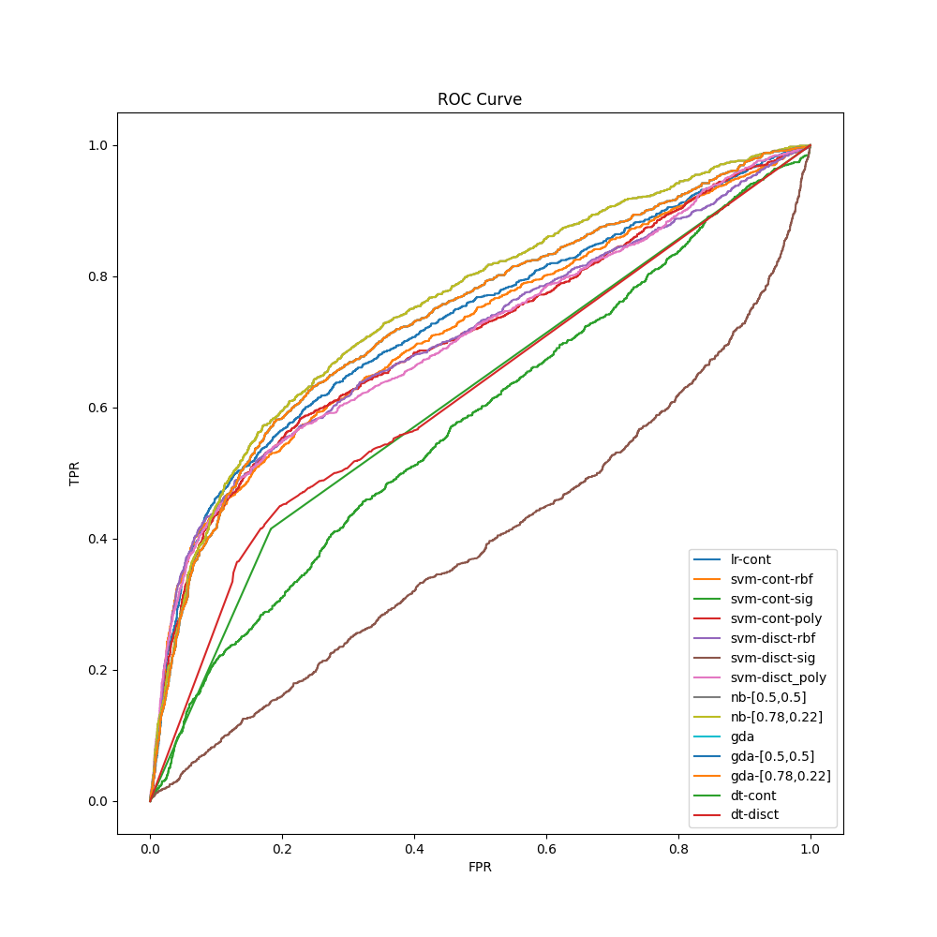
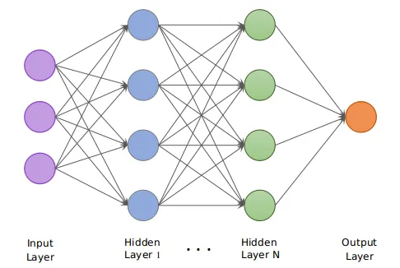
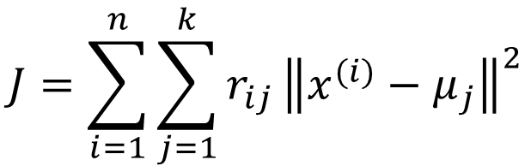
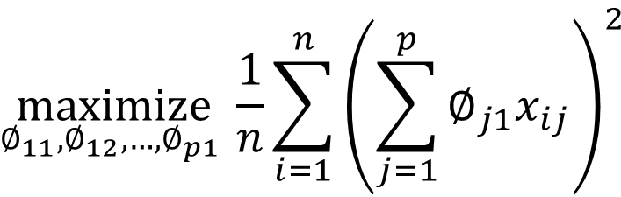
Credit Card Default Analysis – Machine Learning Algorithms
Xinxie Wu, xinxiewu@gmai.com
Predicting
Dataset & Features: Default of Credit Card Clients
2-Part Methodology: Models & Workflow
In banking, Credit Risk is a big issue; Banks use various techniques for Credit Card Default Analysis.
This research applies 2-part methodology into default analysis and prediction, based on the dataset of Default of Credit Card Clients.
In baseline approach, we train Logistic Regression, Naïve Bayes, Gaussian Discriminant Analysis, Decision Tree and SVM for both continuous and discrete features, with total accuracy of ~80% but imbalanced pos-neg gap, >45%.
In improvement stage, SMOTE removes the imbalance gap, but brings overfitting; PCA/K-means refined the dataset and SVM’s retraining results in 99% accuracy; Neural Network is trained and improves accuracy to 90.06%
Dataset has 30k observations, 6,636 (22%) default; includes 23 attributes covering demographic and card historical information. All features are used and further analyzed by PCA & K-means.
EDA:
No Missing Value – Reasonable Values
Normalization & Discretization (9 Categories)
Correlation Matrix – Marriage & Age (0.41)
Training vs Testing: 80% / 20%
Principal Component Analysis (23)
K-means (2)
Baseline Models
$$\underset{∅_{11},∅_{12},…, ∅_{p1} }{maximize}{\frac{1}{n}\sum_{i=1}^{n}{{\left(\sum_{j=1}^{p}{∅_{j1}x_{ij}}\right)}^{2}}}$$
SVM re-training determines the optional # as 23
$$J=\sum_{i=1}^{n}{\sum_{j=1}^{k}{r_{ij}}{\left\|x^{(i)}−μ_{j}\right\|}^{2}}$$
For baseline algorithms:
Continuous: SVM, with rbf kernel, achieves 81.97% accuracy; GDA reaches the highest AUC-ROC as 0.74, with F1 score 0.50.
Discrete: Naïve Bayes, with (0.78, 0.22) prior distribution, gains 80% accuracy; also, this NB reaches AUC-ROC as 0.76.
Logistic Regression shows the highest imbalance gap (73.5%)
Neural Network
Results & Discussion
Dataset is split into training (80%), validation (10%) and testing (10%).
Convolutional layer is NOT in this research.
Results & Discussion:
Baseline models show total accuracy ~80%, but >45% negative-positive gap;
SMOTE removes the neg-pos gap, but brings overfitting (68.60%);
PCA returns an optimal number as 23, K-means removes 9,271 obs. Improved SVM accuracy 99.49%;
Neural network includes 0.8 dropout and gets 90.06%; no convolutional layer in this research.
Future Work
References
For the future work, k-fold cross-validation is under consideration since our research focused on 8/2 dataset split. Also, neural networks with more different number of layers/neurons need to be trained and compare the performance. Finally, SMOTE shows overfitting and so poor generalization ability; methods besides sampling, such as kernel-based and cost-sensitive, should be considered and tested.
[1] Liu, R.L. (2018) Machine Learning Approaches to Predict Default of Credit Card Clients. Modern Economy, 9, 1828-1838.
[2] I-Cheng Yeh, Che-hui Lien. The comparisons of data mining techniques for the predictive accuracy of probability of default of credit card clients. Expert Systems with Applications, Volume 36, Issue 2, Part 1, 2009, Pages 2473-2480, ISSN 0957-4174.
[3] Husejinovic, Admel and Kečo, Dino and Masetic, Zerina, Application of Machine Learning Algorithms in Credit Card Default Payment Prediction (October 1, 2018). A Husejinovic, D Keco, Z Masetic, International Journal of Scientific Research 7 (10), 425-426, 2018.

